Slide 1

Session 9
Selenium Framework Part 2

Slide 2
Topics
Covered
Folder Structure of Framework
Framework configuration
Folder Structure of Components
Writing Component using framework library
Framework library functions
Writing Scenario
Data Input Management
Logs and Reporting

Slide 3
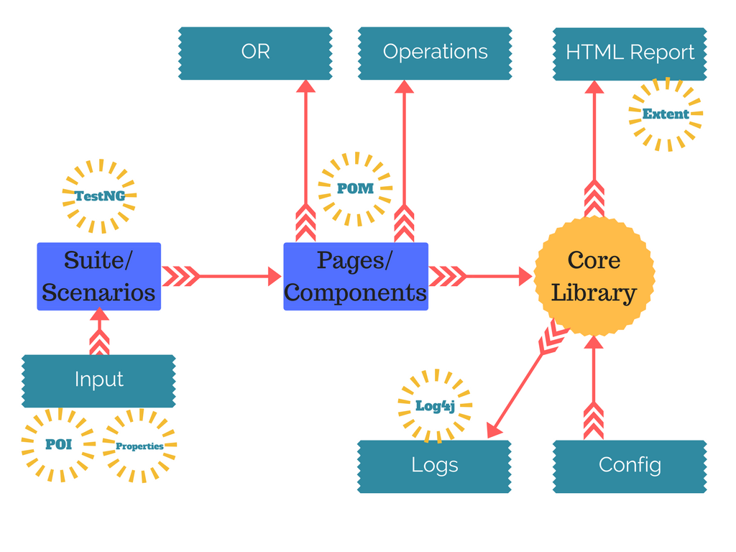
Architecture

Slide 4
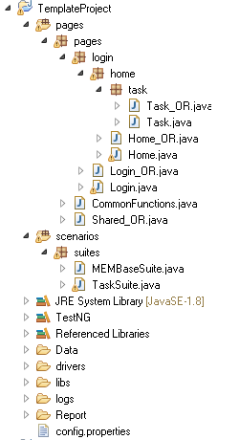
Folder Structure of
Framework
Component / Pages
Scenarios /
Test Suites
Data Management
Global Framework Config

Slide 5
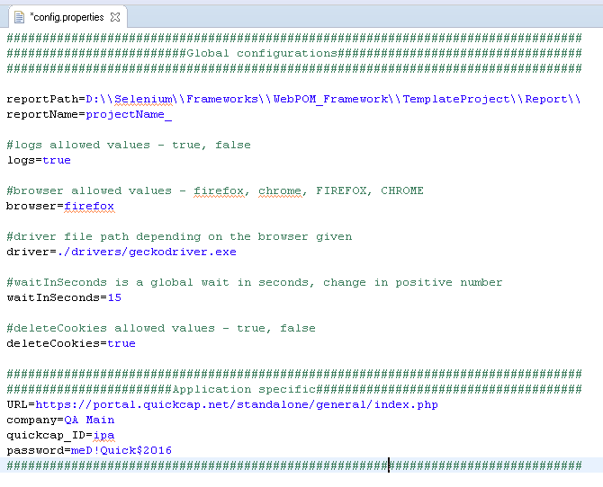
Framework
configuration
Key
Value

Slide 6
Folder Structure of
Components
Based on POM

Slide 7

Writing Component using
framework library
Every component / page must extend BaseComponent

Slide 8
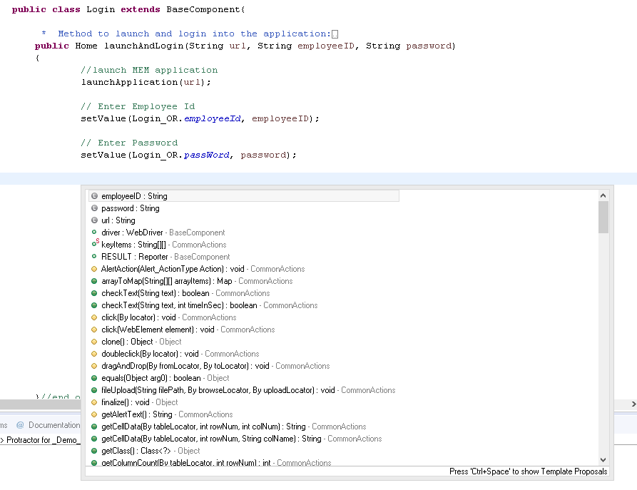
Framework library
functions
Use functions from CommonActions class to perform operations

Slide 9
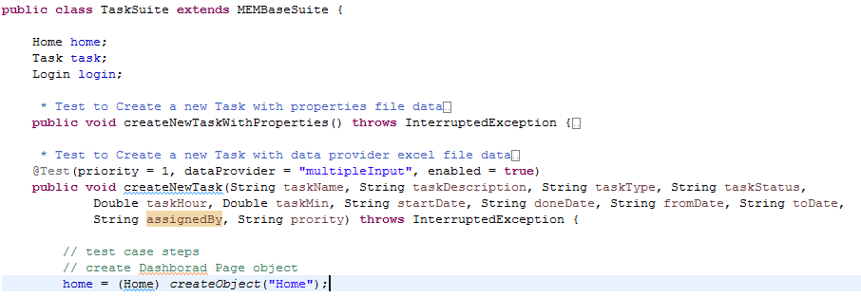
Writing
Scenario
Every suite containing scenarios must extend Project Specific Suite
A scenario/Test Case should have priority with @Test annotation.
It must be public and void.
If multiple iteration, must pass dataProvider=“multipleInput” and parameters inside test method.

Slide 10
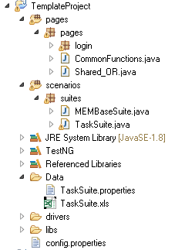
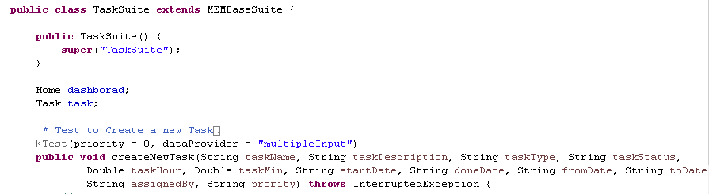
Data Input
Management
Data files should have same name as Suite.
.properties file is optional for every suite. It contains key-value pair data needed
Excel is optional. When enabled dataProvider then you must provide the same for iterations.

Slide 11
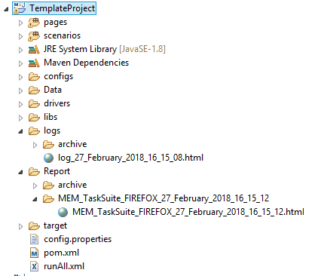
Logs and
Reporting
For every run we will get a report inside Report folder.
If in config.properties ‘logs’ is true then for every run we will have logs in html format.
In every report folder we will have a .html file as per the name given in config.properties appended with timestamp. If any screenshot then under screenshot folder.

Slide 12


Slide 13
Knowledge Check
Brief POM, How we should maintain pages/components?
Why we need reporting?
What are loggers in Log4J?
What are Appenders in Log4J?
What are layouts in Log4J?
How we can manage key, value pair data in Java?
How read Excel data in Java? difference between HSSF vs XSSF?

Slide 14

Thank you!

